Slide 1
Calculating tf-idf cosine scores
in an IR system

Slide 2
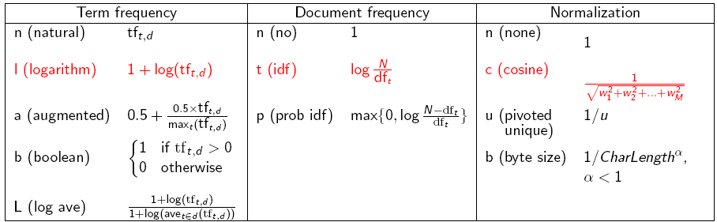
tf-idf weighting has many variants
Sec. 6.4
Notes:
n default is just term frequency
ltc is best known form of weighting

Slide 3
Weighting may differ in queries vs documents
Sec. 6.4
Many search engines allow for different weightings for queries vs. documents
SMART Notation: denotes the combination in use in an engine, with the notation ddd.qqq, using the acronyms from the previous table
A very standard weighting scheme is: lnc.ltc
Document: logarithmic tf (l as first character), no idf and cosine normalization
Query: logarithmic tf (l in leftmost column), idf (t in second column), cosine normalization …
A bad idea?
Notes:
Leaving off idf weighting on documents is good for both efficiency and system effectiveness reasons.

Slide 4
tf-idf example: lnc.ltc
Sec. 6.4
Document: car insurance auto insurance
Query: best car insurance
Term | Query |  |  |  |  |  | Document |  |  |  | Prod
 | tf-raw | tf-wt | df | idf | wt | n’lize | tf-raw | tf-wt | wt | n’lize
auto | 0 | 0 | 5000 | 2.3 | 0 | 0 | 1 | 1 | 1 | 0.52 | 0
best | 1 | 1 | 50000 | 1.3 | 1.3 | 0.34 | 0 | 0 | 0 | 0 | 0
car | 1 | 1 | 10000 | 2.0 | 2.0 | 0.52 | 1 | 1 | 1 | 0.52 | 0.27
insurance | 1 | 1 | 1000 | 3.0 | 3.0 | 0.78 | 2 | 1.3 | 1.3 | 0.68 | 0.53
Exercise: what is N, the number of docs?
Doc length =
Score = 0+0+0.27+0.53 = 0.8

Slide 5
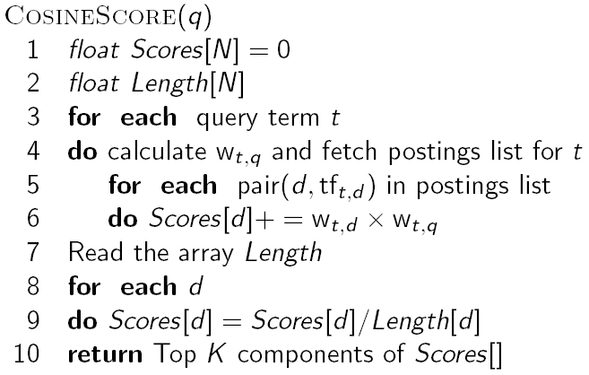
Computing cosine scores
Sec. 6.3
Notes:
Needs to be after the idea of separately weighting query and document terms.

Slide 6
Summary – vector space ranking
Represent the query as a weighted tf-idf vector
Represent each document as a weighted tf-idf vector
Compute the cosine similarity score for the query vector and each document vector
Rank documents with respect to the query by score
Return the top K (e.g., K = 10) to the user

Slide 7
Calculating tf-idf cosine scores
in an IR system

